Slide 1

Flight Ready Electric Feed System
Project No. 13
Sponsored by PSAS and PSU

Slide 2

Team Members
PSAS Electric Feed System
Julio Garcia
Philip Wahl
Nick Sheldon
Henry Ju
Jonas Mendoza
Shayli Elrod

Slide 3
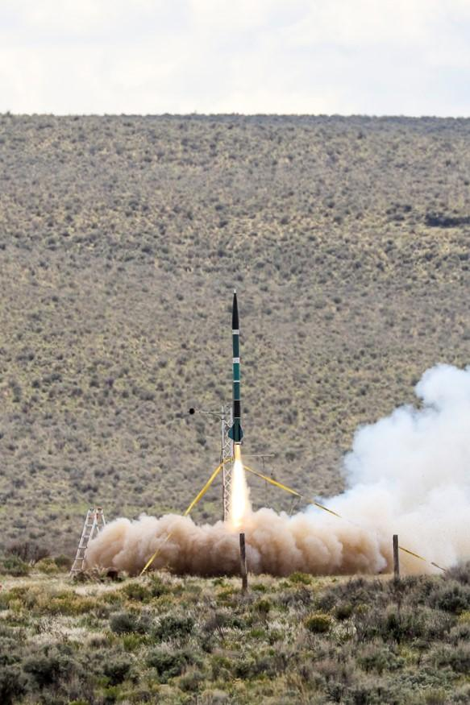
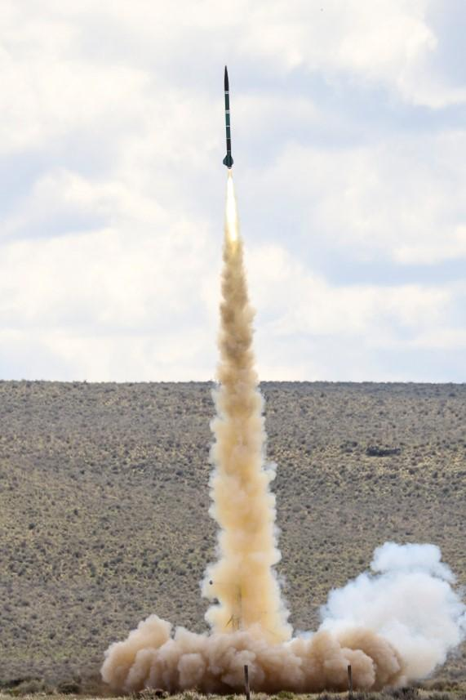
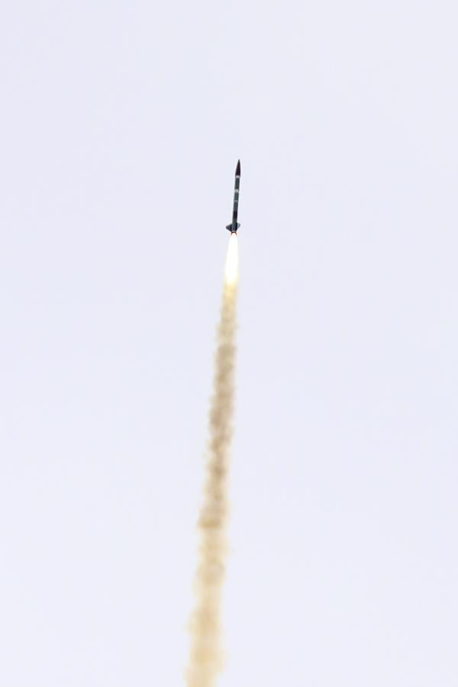
Portland State Aerospace Society
What is PSAS?

Slide 4
Electric Feed System
What is an EFS?
Fuel Tank
Control
Motor
Pump
Nozzle

Slide 5
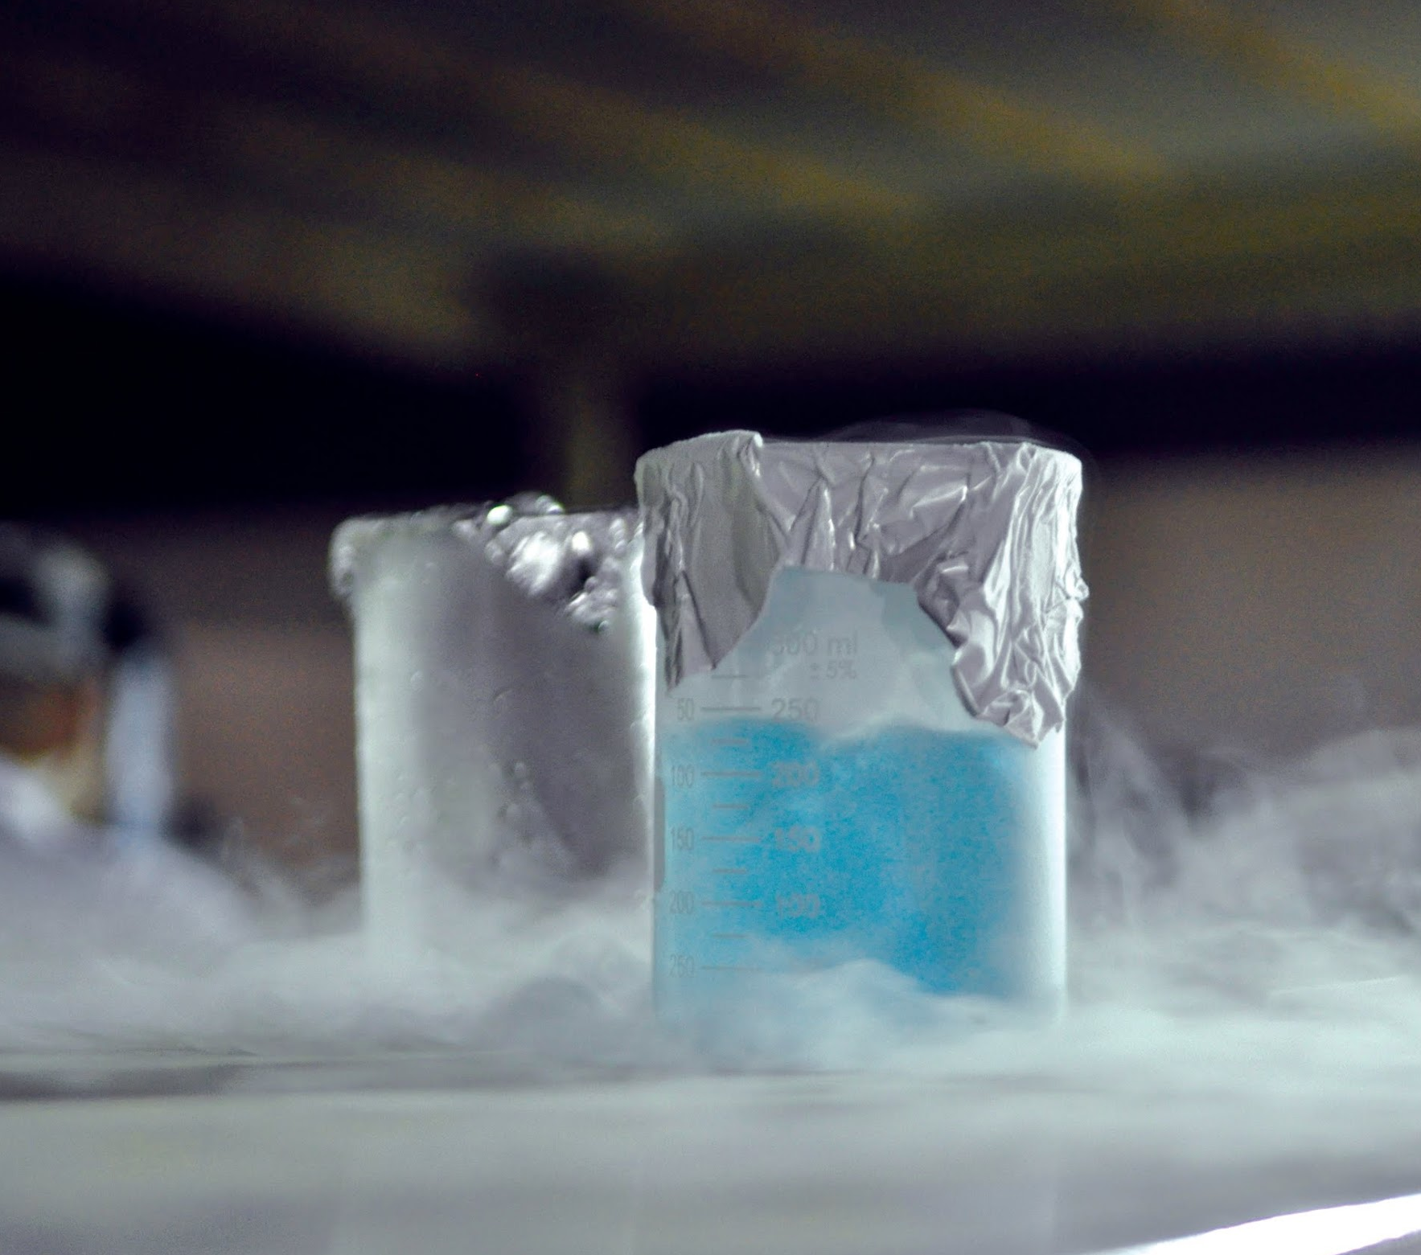
Customer Requirements
PSAS Electric Feed System
Compatibility Requirements
Liquid Oxygen (LOX)
Isopropyl Alcohol
Propellant Safety
Embedded Sensors
Chemical Safety Training for LOX

Slide 6
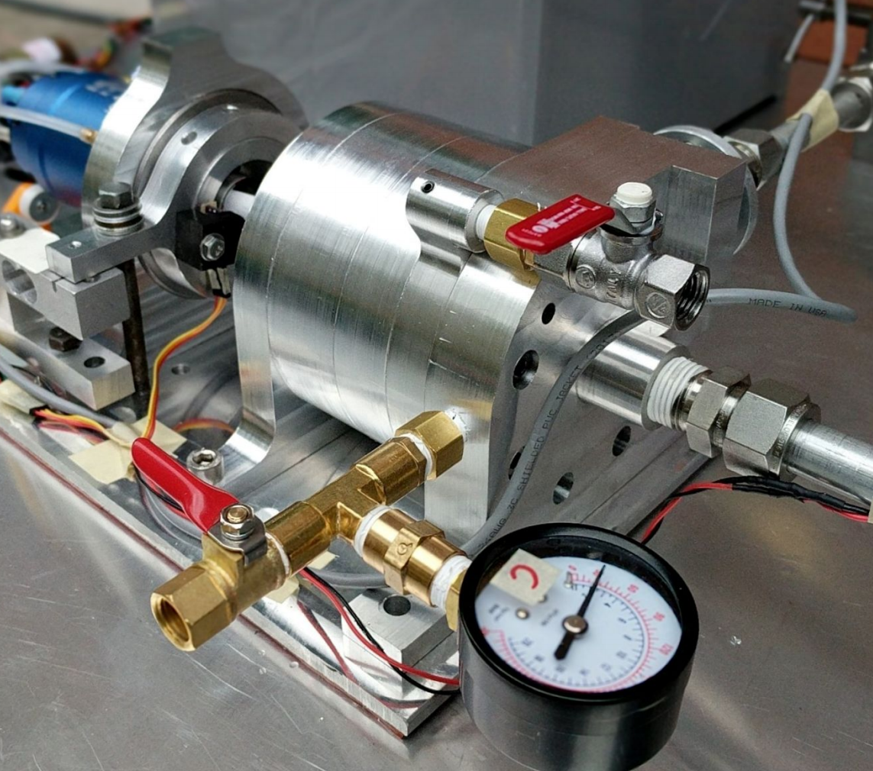
Engineering Requirements
PSAS Electric Feed System
Requirements | Values
Propellant Pressure Gain (lbs) | 400
Flow Rate ( | xx
Motor Spec | xx
 | xx
Acceleration (g) | 10

Slide 7
Milestones
PSAS Electric Feed System
December - January
February - March
April - May
June
Design & Concept
Manufacturing
Testing
Completion

Slide 8
Must Should and May

